Slide 1

Title: Stroke Prediction with Regression based Analysis
Shinjon Ghosh
Graduate Student
Department of Mathematics

Slide 2
Background Study
Stroke is one of the leading causes of morbidity and mortality worldwide.
It has significant health and economic impacts on individuals and healthcare systems.
This project aims to develop predictive models to expect stroke and identify factors influencing stroke risk by World Health Organization stroke data.

Slide 3
Dataset
Collect the dataset from Kaggle. The dataset based on “ Stroke Data” from WHO .
The dataset have 12 variables & 5110 Observations.
Categorical Data – (gender, work_type, smoking_status, Residency_status, ever_married, heart_diseases, hypertension, stroke)
Discrete & Continuous Data – ( Age, Average_Glucose_level, User ID, bmi)

Slide 4
Pre-processing Data
There was a lot of missing values in bmi variable. After find out, I removed those missing observations.
Then I have total 3426 observations. Stroke occurs Yes(180) & No(3246) according to stroke dataset.
Then I use factor function for factorizing gender, work_type, smoking_status, Residency_status, ever_married, heart_diseases, hypertension variable.
The response variable stroke is binary outcome. So, I fit Binomial GLMs model.

Slide 5
Goal
Build a generalized regression model to forecast stroke based on patient demographic and health data.
Identify key factors influencing stroke risk.
Evaluate model performance to identify early strokes and enhance patient treatment.

Slide 6
Main Challenges
Preprocessing the dataset before analysis because the bmi variable has a lot of missing values.
Response variable data is highly imbalanced.

Slide 7
GLMs Analysis By AIC
Models | AIC
st1 | 1164.3
st2 | 1161.5
st3 | 1165.5
st4 | 1154.7
st5 | 1154.6
st6 | 1154.6
st7 | 1154.6

Slide 8
GLMs Forward Selection Algorithm

Slide 9
GLMs Backward Elimination Algorithm

Slide 10
GLMs Stepwise Algorithm

Slide 11
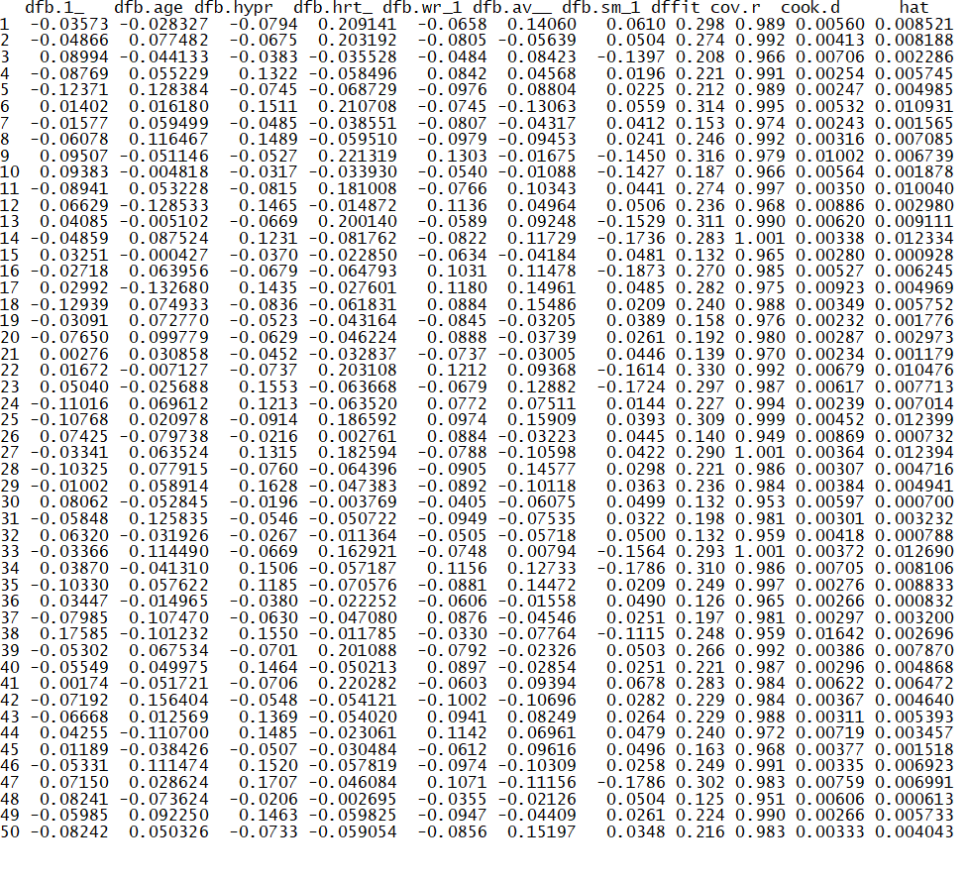
Influential Measures

Slide 12
Multicollinearity

Slide 13
Score Test

Slide 14
Likelihood-Ratio Test

Slide 15
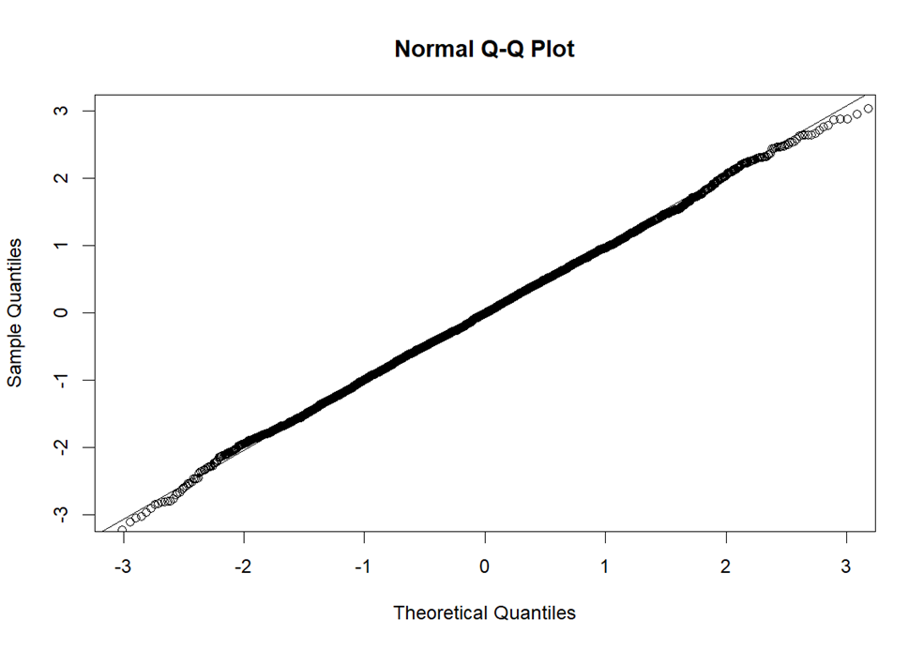
Q-Q Plot

Slide 16
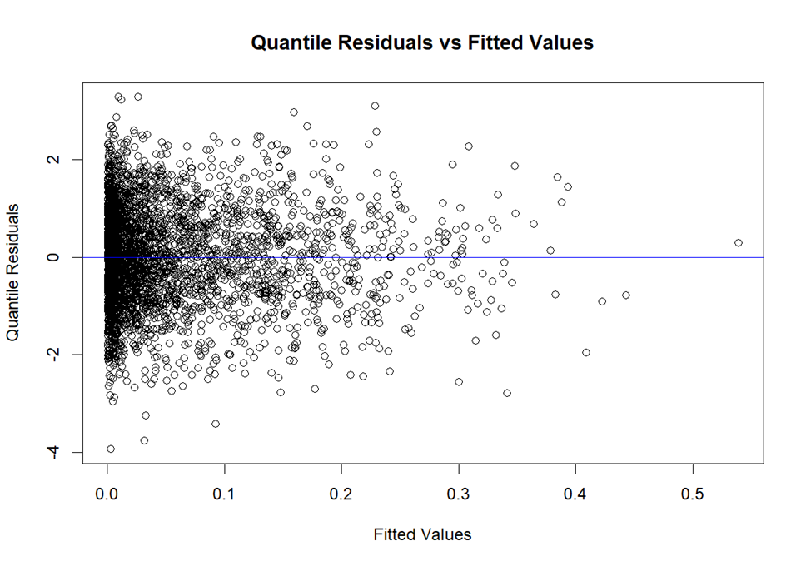
Fitted values vs Quantile Residual

Slide 17
Odds Ratio

Slide 18
Goodness of Fit(Hosmer-Lemeshow tests)
High p-value(>0.05) describes model fits the data well.

Slide 19
Results
According to Score and Likelihhod Ratio test, we say that age, avg_glucose_level, hypertension, heart_disease, work_type and smoking_status variables is significant for stroke.
Odds Ratio:
one year increase of age, the odds of stroke increase by 3.4% and one unit increase of average glucose level, the odds of stroke slightly increase by 0.2%.
The odds that hypertension patient stroke risk 37% higher than those do not have hypertension and the odds that the stroke risk is 24% higher for heart disease patient rather than no heart disease patient.
Subsequently, the odds that the stroke risk is 16% lower for Smoking Status1 (never_smoked, formerly_smoked) patient rather than smoker patients. In addition, the odds that stroke risk is 14% lower for Work Type1 (children, govt. job, self employed, never worked) rather than private job holder.
There is no influential measures by checking of cook’s distance, DFFITS and covariance ratio and there is no multicollinearity by checking VIF.
Subsequently, the model is adequate by Fitted values against quantile residuals plot and the data follows normal distribution according to Q-Q plot.

Slide 20
Limitations and Model Improvement
The Stroke predict dataset has 5100 observation and the bmi variable has a lot of missing values. After removing missing values, the total observation decreased (3426) and later in the model analysis, I found bmi variable was not significant
Response variable is highly imbalance data, so random forest model or gradient descent model can be effective.

Slide 21

Any Questions???

